Slide 1

Wild Oat (Avena Fatua).
Nour Bahaa
Mai Mahmoud
Ibrahim Fawzy
Abanoub George
Dr. Khaled Hussein
Eng. Hager Sobeah

Slide 2

Problems.
Effect on Wheat.
Effect on Soil.
Effect on Production cost.

Slide 3

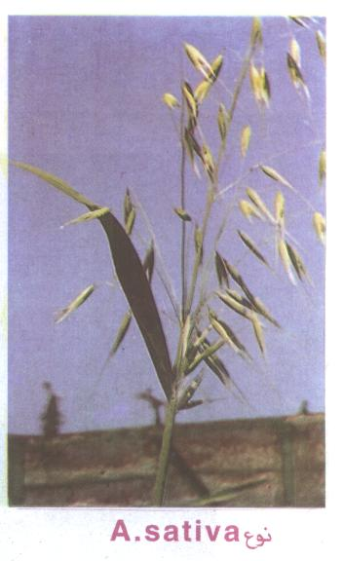
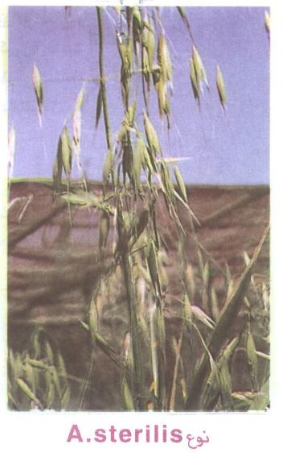
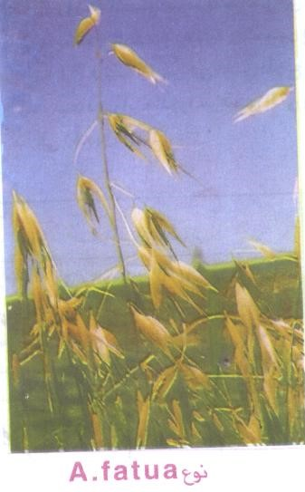
Types of Wild Oat.

Slide 4

How to differentiate between Wild oat and Wheat.
At the beginning stage.(مرحلة البادرة)
Wheat
Wild Oat
At the middle stage.(النمو الخضري)
Wheat
Wild Oat
At the final stage.(طرد سنابل القمح وداليات الزمير)
Wheat
Wild Oat

Slide 5

Related Work.
Image Recognition Method Based on an Improved Convolutional Neural Network to Detect Impurities in Wheat.
https://ieeexplore.ieee.org/document/8865031
Avena fatua (Common Wild Oat).
https://keys.lucidcentral.org/keys/v3/eafrinet/weeds/key/weeds/Media/Html/Avena_fatua_(Common_Wild_Oat).htm
Remote Sensing Detection of Wheat Stripe Rust by Synergized Solar-Induced Chlorophyll Fluorescence and Differential Spectral Index.
https://ieeexplore.ieee.org/document/9107871
دراسات على مقاومة حشيشة الزمير لمبيدى الحشائش (سافيكس و توبيك).
http://main.eulc.edu.eg/eulc_v5/Libraries/Thesis/BrowseThesisPages.aspx?fn=PublicDrawThesis&BibID=10945046

Slide 6

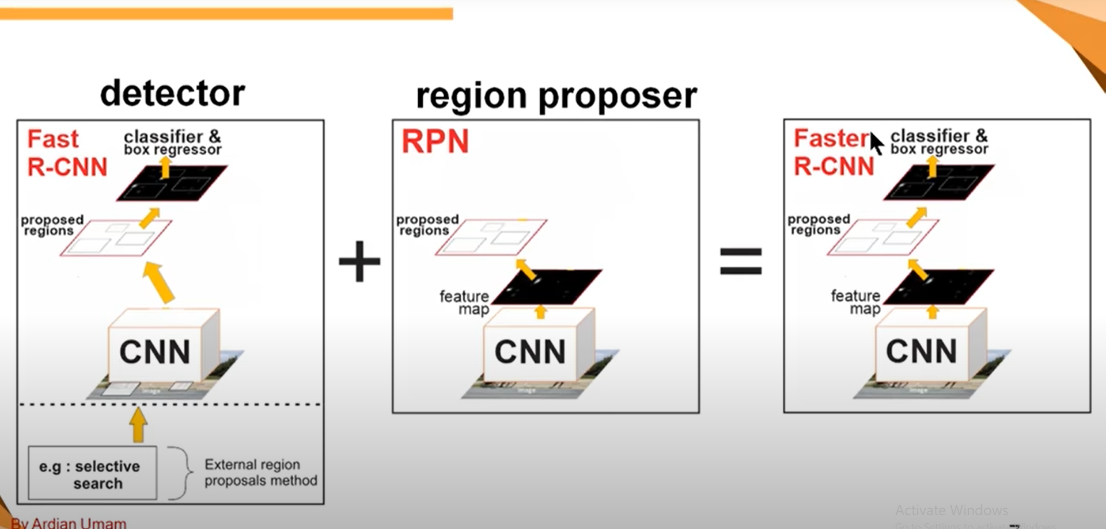
Algorithm I.

Slide 7

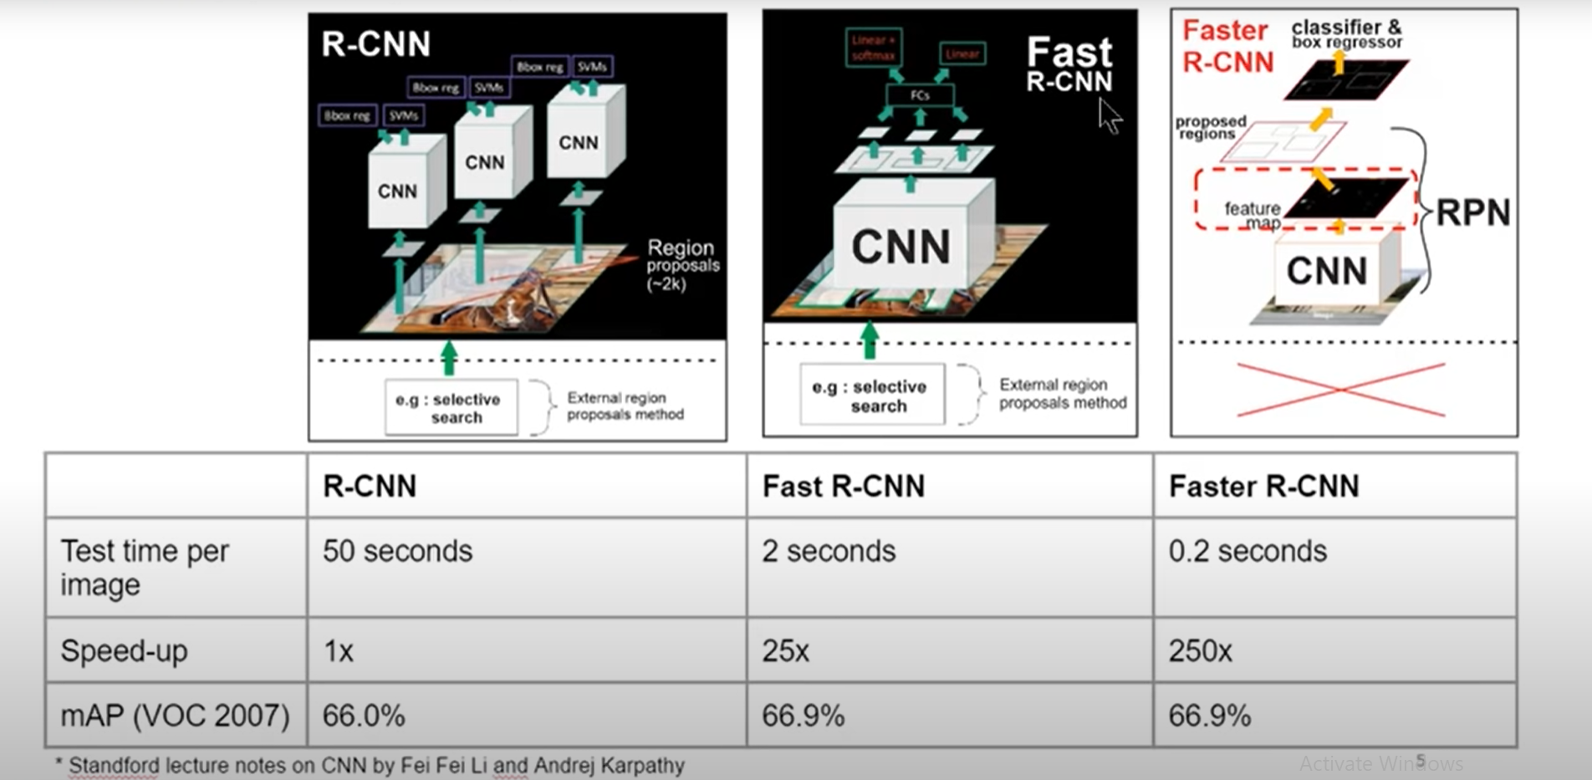
Algorithm II.

Slide 8
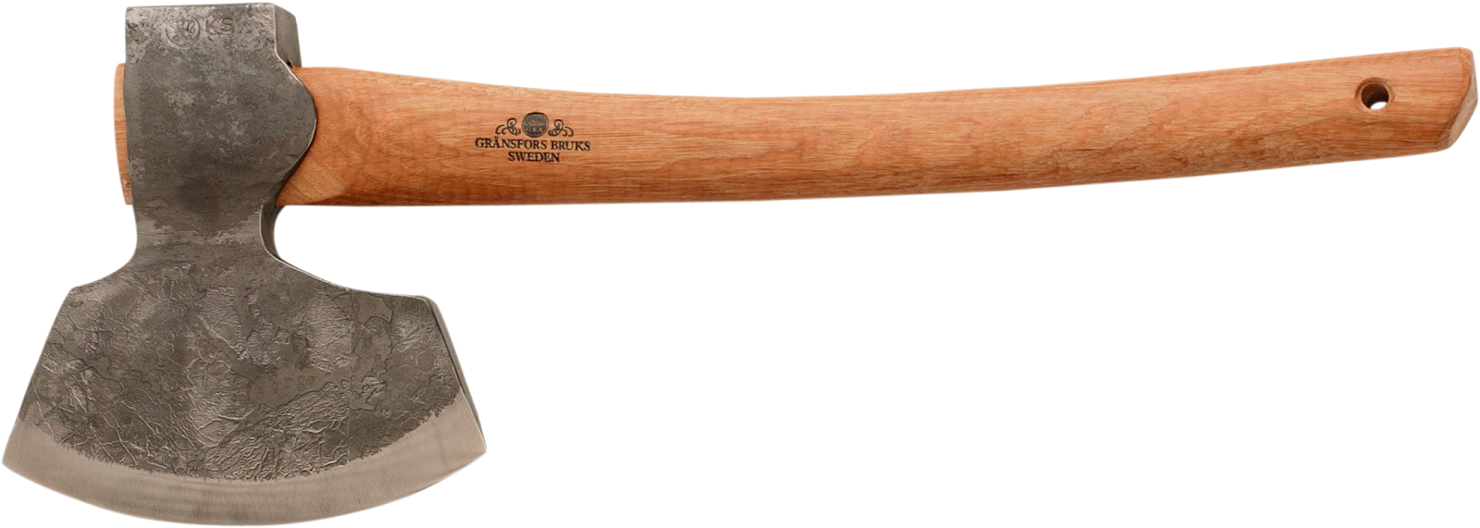
Tools.
1
Camera.
2
Arduino.
3
Cloud.

Slide 9

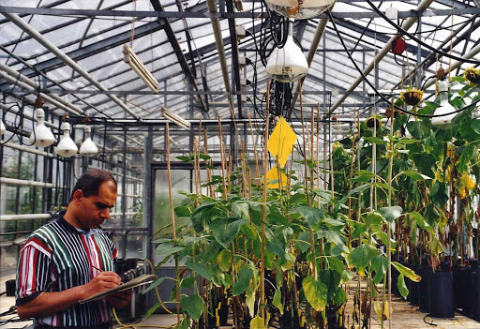
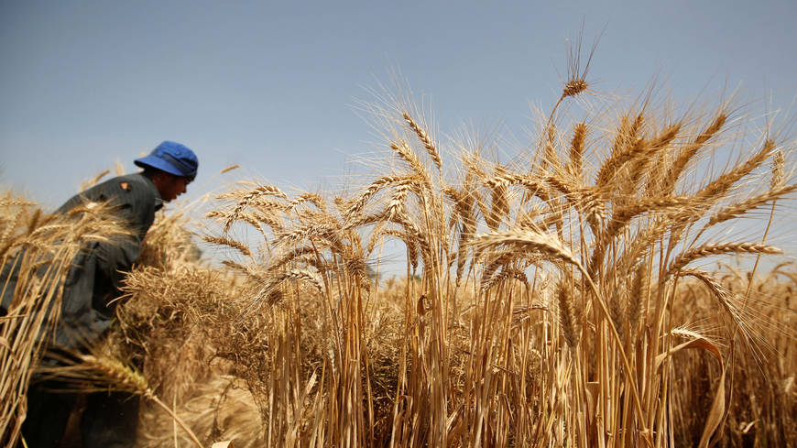
How to solve.
Greenhouse.
Normal Wheat Farms.

Slide 10


The End

